Slide 1
IMAGE CLASSIFICATION & Machine learning BASED medical image CLASSIFICATION

Slide 2
IMAGE CLASSIFICATION
Image classification refers to the labeling of images into one of a number of predefined classes.
There are potentially n number of classes in which a given image can be classified.
Manually checking and classifying images could be a tedious task especially when they are massive in number and therefore it will be very useful if we could automate this entire process using computer vision.
Some examples of image classification include:
Labeling an Brain MRI as containing tumor or not (binary classification).
Classifying a handwritten digit (multiclass classification).
Assigning a name to a photograph of a face (multiclass classification).

Slide 3
TYPICAL IMAGE CLASSIFICATION TASK
Image Preprocessing:
The aim of is to improve the image data(features) by suppressing unwanted distortions and enhancement of some important image features so that the Computer Vision models can benefit from this improved data to work on.
Object Detection:
Detection refers to the localization of an object which means the segmentation of the image and identifying the position of the object of interest.
Feature extraction and Training:
Statistical or deep learning methods are used to identify the most interesting patterns of the image, features that might be unique to a particular class and that will, later on, help the model to differentiate between different classes.
This process where the model learns the features from the dataset is called model training.
Classification of the object:
This step categorizes detected objects into predefined classes by using a suitable classification technique that compares the image patterns with the target patterns.

Slide 4
Image pre-processing activities
Activities in image pre-processing:
Read image
Resize image
Filtering
Data Augmentation (Rotation, Translation, etc.)
Gray scaling of image
Reflection
Gaussian Blurring
Histogram Equalization

Slide 5
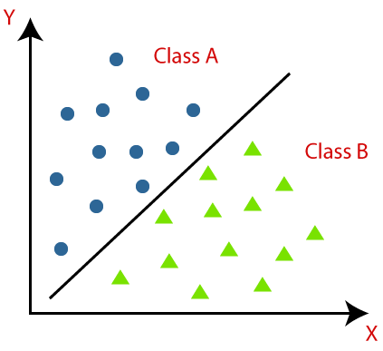
Classification Algorithm in Machine Learning
CLASSIFICATION:
The Classification algorithm is a Supervised Learning technique that is used to identify the category of new observations on the basis of training data.
In Classification, a program learns from the given dataset or observations and then classifies new observation into a number of classes or groups.

Slide 6
TYPES of CLASSIFICATION
Binary Classifier: If the classification problem has only two possible outcomes, then it is called as Binary Classifier. Examples: YES or NO, MALE or FEMALE etc.
Multi-class Classifier: If a classification problem has more than two outcomes, then it is called as Multi-class Classifier. Example: Classifications of types of crops, Classification of types of music etc.

Slide 7
TYPES of ML Classification Algorithms
Linear Models
Logistic Regression
Support Vector Machines
Non-linear Models
K-Nearest Neighbours
Kernel SVM
Naïve Bayes
Decision Tree Classification
Random Forest Classification

Slide 8
METHODS FOR EVALUATING CLASSIFICATION MODEL
Log Loss or Cross-Entropy Loss:
It is used for evaluating the performance of a classifier, whose output is a probability value between the 0 and 1.
For a good binary Classification model, the value of log loss should be near to 0.
The value of log loss increases if the predicted value deviates from the actual value.
The lower log loss represents the higher accuracy of the model.

Slide 9
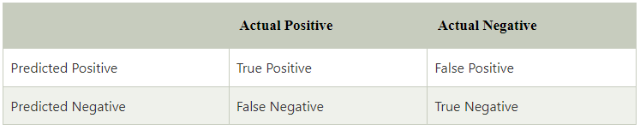
METHODS FOR EVALUATING CLASSIFICATION MODEL
Confusion Matrix:
The confusion matrix provides us a matrix/table as output and describes the performance of the model.
It is also known as the error matrix.
The matrix consists of predictions result in a summarized form, which has a total number of correct predictions and incorrect predictions.

Slide 10
METHODS FOR EVALUATING CLASSIFICATION MODEL
ROC curve:
ROC curve stands for Receiver Operating Characteristics Curve.
It is a graph that shows the performance of the classification model at different thresholds.
The ROC curve is plotted with TPR and FPR, where TPR (True Positive Rate) on Y-axis and FPR(False Positive Rate) on X-axis.

Slide 11
Logistic Regression
Logistic Regression
Logistic regression is a calculation used to predict a binary outcome: either something happens, or does not. This can be exhibited as Yes/No, Pass/Fail, Alive/Dead, etc.
Independent variables are analyzed to determine the binary outcome with the results falling into one of two categories.
The independent variables can be categorical or numeric, but the dependent variable is always categorical. Written like this:
P(Y=1|X) or P(Y=0|X)
It calculates the probability of dependent variable Y, given independent variable X.

Slide 12
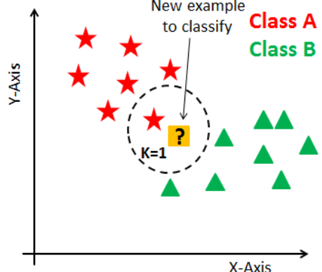
K-Nearest neighbors
K-nearest Neighbors
K-nearest neighbors (k-NN) is a pattern recognition algorithm that uses training datasets to find the k closest relatives in future examples.
When k-NN is used in classification, you calculate to place data within the category of its nearest neighbor. If k = 1, then it would be placed in the class nearest 1.

Slide 13
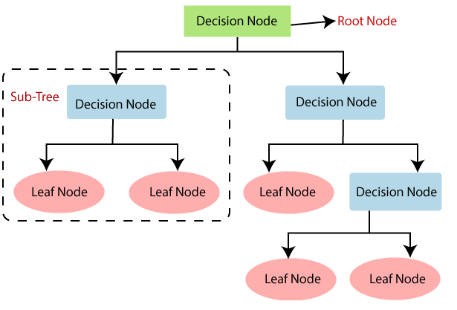
DECISION TREES
Decision Tree Classification Algorithm
Decision Tree is a Supervised learning technique which is a tree-structured classifier,
Internal nodes represent the features of a dataset, branches represent the decision rules and each leaf node represents the outcome.
In a Decision tree, there are two nodes, which are the Decision Node and Leaf Node.
Decision nodes are used to make any decision and have multiple branches.
Leaf nodes are the output of those decisions and do not contain any further branches.
The decisions or the test are performed on the basis of features of the given dataset.

Slide 14
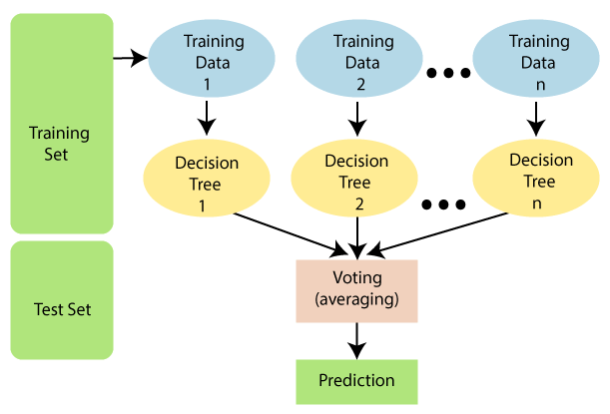
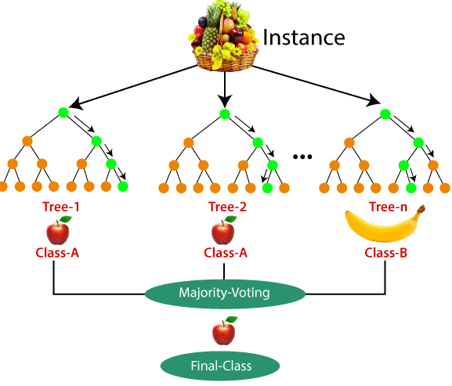
RANDOM FOREST
Random Forest is a classifier that contains a number of decision trees on various subsets of the given dataset and takes the average to improve the predictive accuracy of that dataset.
Instead of relying on one decision tree, the random forest takes the prediction from each tree and based on the majority votes of predictions, and it predicts the final output.
The greater number of trees in the forest leads to higher accuracy and prevents the problem of overfitting.

Slide 15

NAIVE BAYES CLASSIFIER
Naive Bayes Classifier Algorithm
Naive Bayes algorithm is a supervised learning algorithm, which is based on Bayes theorem and used for solving classification problems.
Naïve Bayes Classifier helps in building the fast machine learning models that can make quick predictions.
It is a probabilistic classifier, which means it predicts on the basis of the probability of an object.
Bayes' Theorem:
P(A|B) is Posterior probability: Probability of hypothesis A on the observed event B.
P(B|A) is Likelihood probability: Probability of the evidence given that the probability of a hypothesis is true

Slide 16
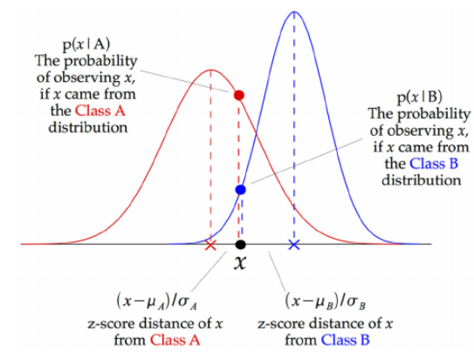
GAUSSIAN NAIVE BAYES
Gaussian Naive Bayes supports continuous valued features and models each as conforming to a Gaussian (normal) distribution.
At every data point, the z-score distance between that point and each class-mean is calculated, namely the distance from the class mean divided by the standard deviation of that class.

